Slide 1
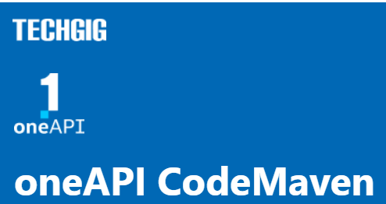
Theme: Healthcare for underserved communities
Team Name: Dark-Knight
Team Members: Suryapratap Singh Suryavanshi

Slide 2
Problem Statement
The problem is healthcare community has multiple regional language barriers in India. I'm a person who pursued my half education in Hindi so I know how it feels when I talk or any other person who is not aware of multiple languages feels that, so it is my motivation to create an application where multiple regional languages and some national languages support translation.

Slide 3
Tech Architecture
We builded an application that is able to cross-platform and support heterogeneity of technology so the oneAPI plays a key role in this project. The tech architecture is based on the NLP, NNL, Scikit-learn, and DPC++ Library for respectively Natural Language Processing, Deep Learning, Machin Learning, and visual representation of the objects in language. In simple representation, we will develop an application with the help of NLP and Neural Network Library, Deep Learning Library to make translation and Scikit-learn to train machines about some regional languages by regional langue data available openly and use the DPC++ library to optimize and visual representation of some language objects.

Slide 4
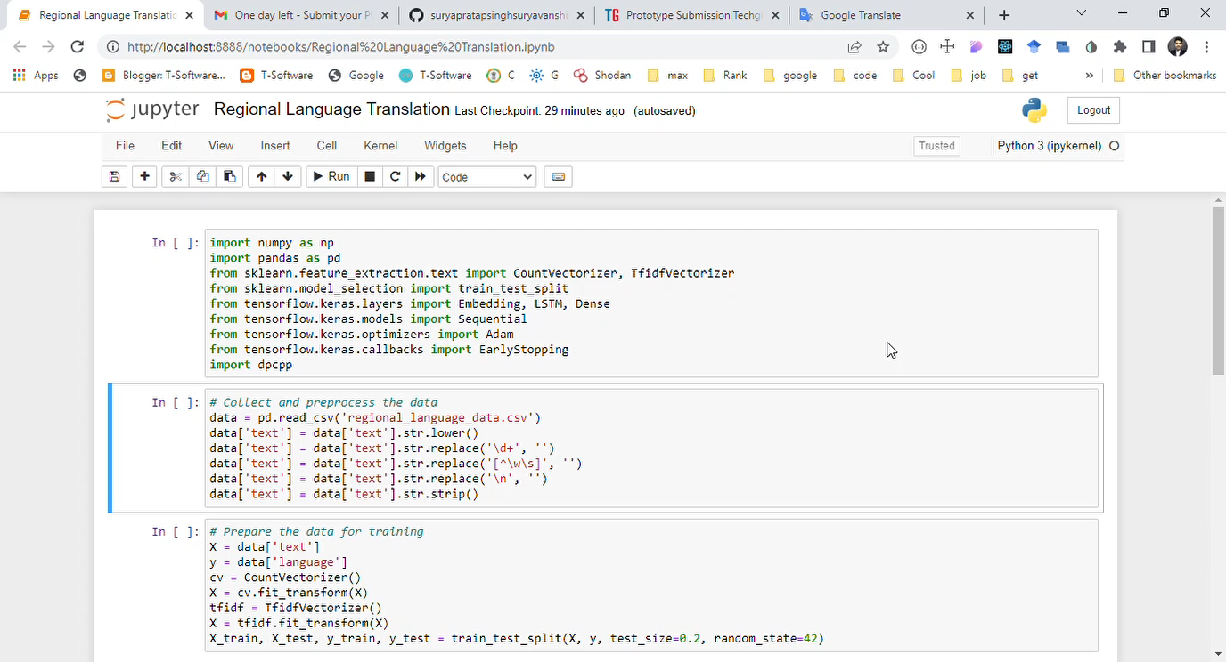
Demo Video
Video Link: https://drive.google.com/file/d/1Wpf-Z4UGESbq8A76cCZ8RY2ZxzhSWSvB/view?usp=sharing

Slide 5
GitHub Link
GitHub Link:
https://github.com/suryapratapsinghsuryavanshi/Regional_Language_Translation_OneAPI

Slide 6
Results Summary
A regional language translator using Natural Language Processing (NLP) involves building a system that can automatically translate text or speech from one regional language to another.
The project typically involves collecting and preprocessing training data, which consists of parallel texts in both the source and target languages. The training data is then used to train a machine learning model that can learn to map input text in the source language to output text in the target language.
Overall, building a regional language translator with NLP can help to bridge the communication gap between different linguistic communities and enable greater access to information and services.
Result Data: In output.xlsx file.

